Slide 1

Due: Wed. two weeks later at 23:59:59
Filename: HW#_StuID.zip
  Ex) HW3_Q123456.zip
Introduction to Computers 1

Slide 2
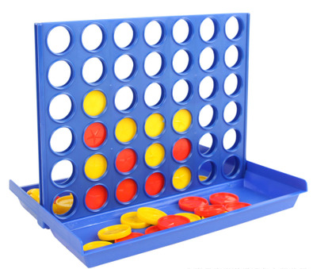

Rules
  6 rows, 7columns
  Two players
  21 red discs and 21 yellow discs
  Every round, players drop one of their discs into an unfilled column
  The player who achieves “four in a row” first is the winner
  If the game board fills before player achieve four in a row, the game is a draw
Introduction to Computers 1

Slide 3
Requirements-1:
  Write a program letting 2 users play Connect Four
  Use only basic rules
  Update and show the game board after each move
  When the game ends, determine and show which player is the winner or the game is a draw
  Include a “README.txt” to instruct how to play your game
Introduction to Computers 1

Slide 4
Requirements-2:
  Write an AI to compete with your classmates
  Upload one header file only → Stu_ID.h
Introduction to Computers 1

Slide 5
You can get three files from TA
  Source.cpp : Don’t change any code in this file
  E12345678.h : Change the file name and function name to your Stu_ID → Upload this file only
  Poor_AI.h : Write a simple AI for testing
  Change E12345678.h to Stu_ID.h after completing AI or you have to change file name and function name in source code.
Introduction to Computers 1

Slide 6
Source.cpp
Call two AIs to compete for 100 times
Players drop the first disc by turns
The AI which wins more times is the winner
The round ends by some cases
  Someone wins when connecting four
  The board is full (Draw Game)
  Someone does illegal move (The other player wins)
Introduction to Computers 1

Slide 7
Source.cpp
vector < vector<char> >board
Use 6x7 vector to store the state of board
0 1 2 3 4 5 6
0
1
2
3
4
5
 |  | X | O
 |  | O | X
 | X | O | O | X
Introduction to Computers 1

Slide 8
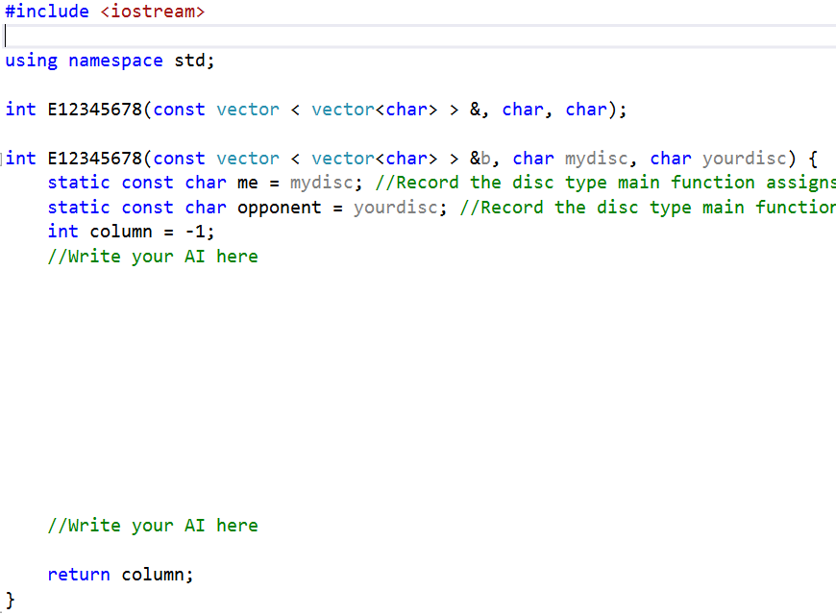
Change file name and
function name to your Stu_ID before uploading
E12345678.h
Given: board, disc (O or X)
Return: updated board
Introduction to Computers 1

Slide 9
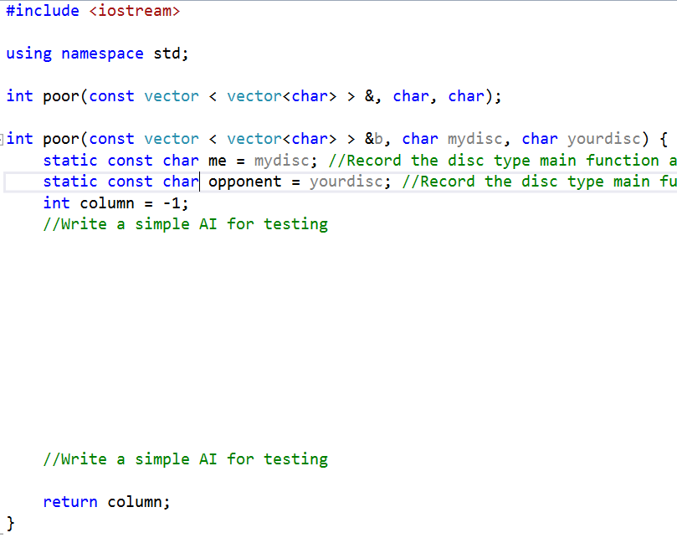
Poor_AI.h
Introduction to Computers 1

Slide 10
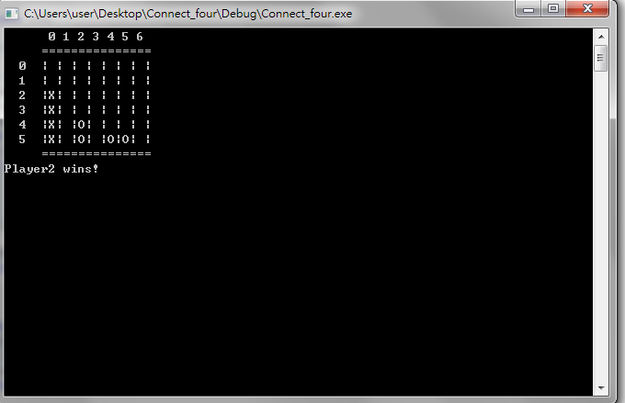
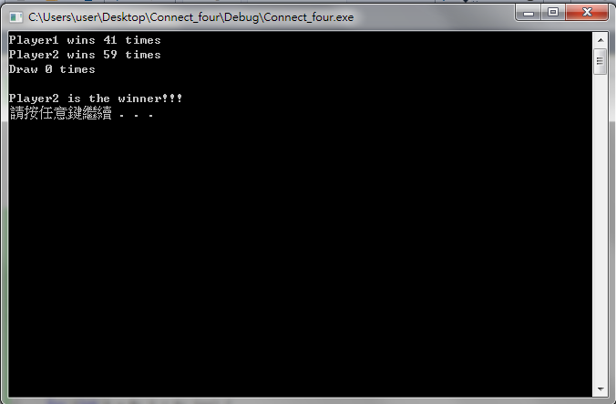
DEMO
Introduction to Computers 1

